Slide 1
MIPS Pipeline

Slide 2
Pipelining
Not pipelined
Assume 30 min. each task – wash, dry, fold, store – and that separate tasks use separate hardware and so can be overlapped
Pipelined

Slide 3
Pipelined vs. Single-Cycle Instruction Execution: the Plan
P
r
o
g
r
a
m
2
4
6
8
1
0
1
2
1
4
1
6
1
8
e
x
e
c
u
t
i
o
n
T
i
m
e
o
r
d
e
r
Single-cycle
(
i
n
i
n
s
t
r
u
c
t
i
o
n
s
)
l
w
$
1
,
1
0
0
(
$
0
)
I
n
s
t
r
u
c
t
i
o
n
R
e
g
A
L
U
D
a
t
a
R
e
g
f
e
t
c
h
a
c
c
e
s
s
l
w
$
2
,
2
0
0
(
$
0
)
8
n
s
I
n
s
t
r
u
c
t
i
o
n
R
e
g
A
L
U
D
a
t
a
R
e
g
f
e
t
c
h
a
c
c
e
s
s
l
w
$
3
,
3
0
0
(
$
0
)
8
n
s
I
n
s
t
r
u
c
t
i
o
n
f
e
t
c
h
.
.
.
8
n
s
Assume 2 ns for memory access, ALU operation; 1 ns for register access:
therefore, single cycle clock 8 ns; pipelined clock cycle 2 ns.
P
r
o
g
r
a
m
2
4
6
8
1
0
1
2
1
4
e
x
e
c
u
t
i
o
n
T
i
m
e
o
r
d
e
r
(
i
n
i
n
s
t
r
u
c
t
i
o
n
s
)
I
n
s
t
r
u
c
t
i
o
n
D
a
t
a
l
w
$
1
,
1
0
0
(
$
0
)
f
e
t
c
h
R
e
g
A
L
U
a
c
c
e
s
s
R
e
g
Pipelined
l
w
$
2
,
2
0
0
(
$
0
)
2
n
s
I
n
s
t
r
u
c
t
i
o
n
R
e
g
A
L
U
D
a
t
a
R
e
g
f
e
t
c
h
a
c
c
e
s
s
I
n
s
t
r
u
c
t
i
o
n
D
a
t
l
w
$
3
,
3
0
0
(
$
0
)
2
n
s
R
e
g
A
a
L
U
R
f
e
g
e
t
c
h
a
c
c
e
s
s
2
n
s
2
n
s
2
n
s
2
n
s
2
n
s

Slide 4
The Five Stages of Load
Cycle 1
Cycle 2
Cycle 3
Cycle 4
Cycle 5
Load
Ifetch
Reg/Dec
Exec
Mem
Wr
Ifetch: Instruction Fetch
Fetch the instruction from the Instruction Memory
Reg/Dec: Registers Fetch and Instruction Decode
Exec: Calculate the memory address
Mem: Read the data from the Data Memory
Wr: Write the data back to the register file
Notes:
As shown here, each of these five steps will take one clock cycle to complete.
And in pipeline terminology, each step is referred to as one stage of the pipeline.

Slide 5
Key Ideas Behind Pipelining
The load instruction has 5 stages:
Five independent functional units to work on each stage
Each functional unit is used only once
The 2nd load can start as soon as the 1st finishes its Ifetch stage
Each load still takes five cycles to complete
The throughput, however, is much higher
Notes:
Here’s an overview of how pipeline work with an analogy:
In the T1 exam, there were five problems. For simplicity, let’s say there are five of faculty members who have to check the big pile of answer sheets.
The most efficient way to do this is to assign one problem to each faculty, so that EACH faculty ONLY has to grade one particular problem and be very efficient at it.
Now as soon as that person finish grading the problem assigned to him, he can just pass the answer sheet to the next person so the next problem can be graded.
Assume each problem takes half an hour to grade, then each individual answer sheet still takes 2.5 hours to grade but with 5 people working together, the big pile of answersheets can be done much quicker than if they have to be graded by a single faculty.
Similarly, the load instruction has five stages. So if the datapath has 5 independent functional units that are specialized to work on each stage, then as soon as the first load instruction finishes its first stage, we can start the second load instruction.
If we look at one Load instruction at a time, we will notice that each Load still takes five cycles to complete in the pipeline processor, just like the multiple cycle processor.
However, if we look at the big picture, we will notice that over the same period of time, the pipeline processor can complete many more instructions (throughput) than the multiple cycle processor because the pipeline processor will start working on the next instruction before the previous one finishes.

Slide 6
Key Ideas Behind Pipelining
Input
Tasks
buffer
Stage 1
Stage 2
K – stage pipeline
Stage k
Let n= number of tasks or answer sheets (or instructions)
Let k = number of stages for each task
Let T= the time per stage
Time per task = T . k
Total Time per n tasks for non-pipelined solution = T . k . n
Total Time per n tasks for pipelined solution = T . k + T . (n-1)
Speedup = pipelined performance/ non-pipelined performance
= Total Time non-pipelined/Total Time for pipelined
= k . n / k + n-1
≈ k when n >> k

Slide 7
Pipelining: Keep in Mind
Pipelining does not reduce latency of a single task, it increases throughput of entire workload
Pipeline rate is limited by longest stage
potential speedup = number pipe stages
unbalanced lengths of pipeline stages reduces speedup

Slide 8
Pipelining the Load Instruction
Cycle 1
Cycle 2
Cycle 3
Cycle 4
Cycle 5
Cycle 6
Cycle 7
Clock
1st lw
Ifetch
Reg/Dec
Exec
Mem
Wr
2nd lw
Ifetch
Reg/Dec
Exec
Mem
Wr
3rd lw
Ifetch
Reg/Dec
Exec
Mem
Wr
The five independent functional units in the pipeline datapath are:
Instruction Memory for the Ifetch stage
Register File’s Read ports (bus A and busB) for the Reg/Dec stage
ALU for the Exec stage
Data Memory for the Mem stage
Register File’s Write port (bus W) for the Wr stage
One instruction enters the pipeline every cycle
One instruction comes out of the pipeline (complete) every cycle
The “Effective” Cycles per Instruction (CPI) is 1
Notes:
Notice that we have treated Register File’s read and write ports as separate functional units because the register file allows us to read and write at the same time.
Notice that as soon as the 1st load finishes its Ifetch stage, it no longer needs the Instruction Memory. Consequently, the 2nd load can start using the Instruction Memory (2nd Ifetch).
Furthermore, since each functional unit is only used ONCE per instruction, we will not have any conflict down the pipeline (Exec-Ifet, Mem-Exec, Wr-Mem) either.
Lets point out the performance advantages of pipelining:
If these 3 load instructions are to be executed by the multiple cycle processor, it will take 15 cycles. But with pipelining, it only takes 7 cycles. This (7 cycles), however, is not the best way to look at the performance advantages of pipelining.
A better way to look at this is that we have one instruction enters the pipeline every cycle so we will have one instruction coming out of the pipeline (Wr stages) every cycle.
Consequently, the “effective” (or average) number of cycles per instruction is now ONE even though it takes a total of 5 cycles to complete each instruction.

Slide 9
The Four Stages of R-type
Cycle 1
Cycle 2
Cycle 3
Cycle 4
R-type
Ifetch
Reg/Dec
Exec
Wr
Ifetch: Instruction Fetch
Fetch the instruction from the Instruction Memory
Reg/Dec: Registers Fetch and Instruction Decode
Exec: ALU operates on the two register operands
Wr: Write the ALU output back to the register file
Notes:
Let’s take a look at the R-type instructions.
The R-type instruction does NOT access data memory so it only takes four clock cycles, or in our new pipeline terminology, four stages to complete.
The Ifetch and Reg/Dec stages are identical to the Load instructions. Well they have to be because at this point, we do not know we have a R-type instruction yet.
Instead of calculating the effective address during the Exec stage, the R-type instruction will use the ALU to operate on the register operands.
The result of this ALU operation is written back to the register file during the Wr back stage.

Slide 10
Pipelining the R-type and Load Instruction
Cycle 1
Cycle 2
Cycle 3
Cycle 4
Cycle 5
Cycle 6
Cycle 7
Cycle 8
Cycle 9
Clock
R-type
Ifetch
Reg/Dec
Exec
Wr
Oops! We have a problem!
R-type
Ifetch
Reg/Dec
Exec
Wr
Load
Ifetch
Reg/Dec
Exec
Mem
Wr
R-type
Ifetch
Reg/Dec
Exec
Wr
R-type
Ifetch
Reg/Dec
Exec
Wr
We have a problem:
Two instructions try to write to the register file at the same time!
Notes:
What happened if we try to pipeline the R-type instructions with the Load instructions?
Well, we have a problem here: We end up having two instructions trying to write to the register file at the same time!
Why do we have this problem (the write “bubble”)?

Slide 11
Important Observation
Each functional unit can only be used once per instruction
Each functional unit must be used at the same stage for all instructions:
Load uses Register File’s Write Port during its 5th stage
But R-type uses Register File’s Write Port during its 4th stage
1
2
3
4
5
Load
Ifetch
Reg/Dec
Exec
Mem
Wr
1
2
3
4
R-type
Ifetch
Reg/Dec
Exec
Wr
Notes:
As already explained, in order for pipeline to work perfectly, each functional unit can ONLY be used once per instruction.
This is a necessary but NOT sufficient condition for pipeline to work.
The other condition to prevent pipeline stall is that each functional unit must be used at the same stage for all instructions.
For example here, the load instruction uses the Register File’s Wr port during its 5th stage but the R-type instruction right now will use the Register File’s port during its 4th stage.
This (5 versus 4) is what caused problem. How do we solve it?

Slide 12
Solution 1: Insert “Bubble” into the Pipeline
Cycle 1
Cycle 2
Cycle 3
Cycle 4
Cycle 5
Cycle 6
Cycle 7
Cycle 8
Cycle 9
Clock
Ifetch
Reg/Dec
Exec
Wr
Load
Ifetch
Reg/Dec
Exec
Mem
Wr
R-type
Ifetch
Reg/Dec
Exec
Wr
R-type
Ifetch
Reg/Dec
Pipeline
Exec
Wr
R-type
Ifetch
Bubble
Reg/Dec
Exec
Wr
Ifetch
Reg/Dec
Exec
Insert a “bubble” into the pipeline to prevent 2 writes at the same cycle
The control logic can be complex
No instruction is completed during Cycle 5:
The “Effective” CPI for load is 2
Notes:
The first solution is to insert a “bubble” into the pipeline AFTER the load instruction to push back every instruction after the load that are already in the pipeline by one cycle.
At the same time, the bubble will also delay the Instruction Fetch of the instruction that is about to enter the pipeline by one cycle.
Needless to say, the control logic to accomplish this can be complex. Furthermore, this solution also has a negative impact on performance.
Notice that due to the “extra” stage (Mem) that the Load instruction has, we will not have one instruction finishes every cycle (see the Cycle 5).
Consequently, a mix of load and R-type instruction will NOT have an average CPI of 1 because in effect, the Load instruction has an effective CPI of 2.
So this is not a Good idea and therefore Let’s try something else.

Slide 13
Solution 2: Delay R-type’s Write by One Cycle (NOP)
Delay R-type’s register write by one cycle:
Now R-type instructions also use Reg File’s write port at Stage 5
Mem stage is a NOP stage: nothing is being done
1
2
3
4
5
R-type
Ifetch
Reg/Dec
Exec
Mem
Wr
Cycle 1
Cycle 2
Cycle 3
Cycle 4
Cycle 5
Cycle 6
Cycle 7
Cycle 8
Cycle 9
Clock
R-type
Ifetch
Reg/Dec
Exec
Mem
Wr
R-type
Ifetch
Reg/Dec
Exec
Mem
Wr
Load
Ifetch
Reg/Dec
Exec
Mem
Wr
R-type
Ifetch
Reg/Dec
Exec
Mem
Wr
R-type
Ifetch
Reg/Dec
Exec
Mem
Wr
Notes:
One thing we can do is to add a “Nop” stage to the R-type instruction pipeline to delay its register file write by one cycle.
Now the R-type instruction ALSO uses the register file’s witer port at its 5th stage so we eliminate the write conflict with the load instruction.
This is a much simpler solution as far as the control logic is concerned. As far as performance is concerned, we also gets back to having one instruction completes per cycle.
By making each individual R-type instruction takes 5 cycles instead of 4 cycles to finish, our overall performance is actually becomes better.
The reason for this higher performance is that we end up having a more efficient pipeline.

Slide 14
The Four Stages of Store
Cycle 1
Cycle 2
Cycle 3
Cycle 4
Store
Ifetch
Reg/Dec
Exec
Mem
Wr
Ifetch: Instruction Fetch
Fetch the instruction from the Instruction Memory
Reg/Dec: Registers Fetch and Instruction Decode
Exec: Calculate the memory address
Mem: Write the data into the Data Memory
Notes:
Once again, the Ifetch and Reg/Decode stages are the same as all other instructions.
The Exec stage of the store instruction calculates the memory address.
Once the address is calculated, the store instruction will write the data it read from the register file back at the Reg/Decode stage into the data memory during the Mem stage.
Notice that unlike the load instruction which takes five cycles to accomplish its task, the Store instruction only takes four cycles or four pipe stages.
In order to keep our pipeline diagram looks more uniform, however, we will keep the Wr stage for the store instruction in the pipeline diagram.
But keep in mind that as far as the pipelined control and pipelined datapath are concerned, the store instruction requires NOTHING to be done once it finishes its Mem stage.

Slide 15
The Four Stages of Beq
Cycle 1
Cycle 2
Cycle 3
Cycle 4
Beq
Ifetch
Reg/Dec
Exec
Mem
Wr
Ifetch: Instruction Fetch
Fetch the instruction from the Instruction Memory
Reg/Dec: Registers Fetch and Instruction Decode
Exec: ALU compares the two register operands
Adder calculates the branch target address
Mem: If the registers we compared in the Exec stage are the same,
Write the branch target address into the PC
Notes:
Similar to the store instruction, the branch instruction only consists of four pipe stages.
Ifetch and Reg/decode are the same as all other instructions because we do not know what instruction we have at this point. We have not finish decoding the instruction yet.
During the Execute stage of the pipeline, the BEQ instruction will use the ALU to compare the two register operands it fetched during the Reg/Dec stage.
At the same time, a separate adder is used to calculate the branch target address.
If the registers we compared during the Execute stage have the same value, the branch is taken.
That is, the branch target address we calculated earlier will be written into the Program Counter.
Once again, similar to the Store instruction, the BEQ instruction will require NEITHER the pipelined control nor the pipelined datapath to do ANY thing once it finishes its Mem stage.

Slide 16
Pipelining MIPS
What makes it easy with MIPS?
all instructions are same length
so fetch and decode stages are similar for all instructions
just a few instruction formats
simplifies instruction decode and makes it possible in one stage
memory operands appear only in load/stores
so memory access can be deferred to exactly one later stage
operands are aligned in memory
one data transfer instruction requires one memory access stage

Slide 17
Pipelining MIPS
What makes it hard?
Structural hazards: different instructions, at different stages, in the pipeline want to use the same hardware resource
Control hazards: succeeding instruction, to put into pipeline, depends on the outcome of a previous branch instruction, already in pipeline
Data hazards: an instruction in the pipeline requires data to be computed by a previous instruction still in the pipeline
Notes:
Before actually building the pipelined datapath and control we first briefly examine these potential hazards individually…

Slide 18
Structural Hazards
Structural hazard: inadequate hardware to simultaneously support all instructions in the pipeline in the same clock cycle
E.g., suppose single instruction/ data memory in pipeline below with one read port only
then a structural hazard between first and fourth lw instructions
MIPS was designed to be pipelined: structural hazards are easy to avoid!
P
r
o
g
r
a
m
2
4
6
8
1
0
1
2
1
4
e
x
e
c
u
t
i
o
n
T
i
m
e
o
r
d
e
r
(
i
n
i
n
s
t
r
u
c
t
i
o
n
s
)
I
n
s
t
r
u
c
t
i
o
n
D
a
t
a
l
w
$
1
,
1
0
0
(
$
0
)
f
e
t
c
h
R
e
g
A
L
U
a
c
c
e
s
s
R
e
g
Pipelined
l
w
$
2
,
2
0
0
(
$
0
)
2
n
s
I
n
s
t
r
u
c
t
i
o
n
R
e
g
A
L
U
D
a
t
a
R
e
g
Hazard if single memory
f
e
t
c
h
a
c
c
e
s
s
l
w
$
3
,
3
0
0
(
$
0
)
2
n
s
I
n
s
t
r
u
c
t
i
o
n
R
e
g
A
L
U
D
a
t
a
R
e
g
f
e
t
c
h
a
c
c
e
s
s
l
w
$
4
,
4
0
0
(
$
0
)
I
n
s
t
r
u
c
t
i
o
n
R
e
g
A
L
U
D
a
t
a
R
e
g
2
n
s
f
e
t
c
h
a
c
c
e
s
s
2
n
s
2
n
s
2
n
s
2
n
s
2
n
s

Slide 19
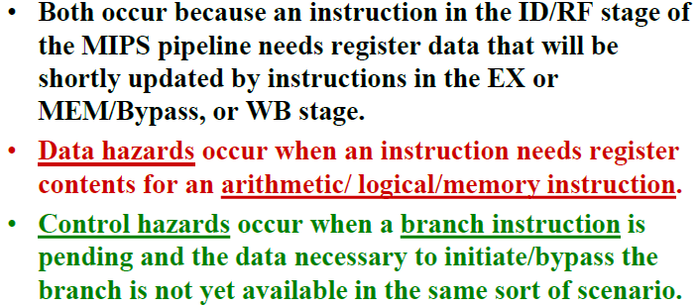
Data And Control Hazards

Slide 20
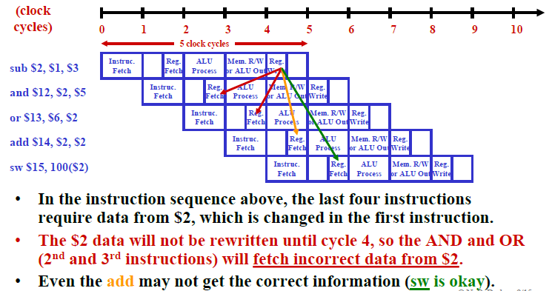
Data Hazards

Slide 21
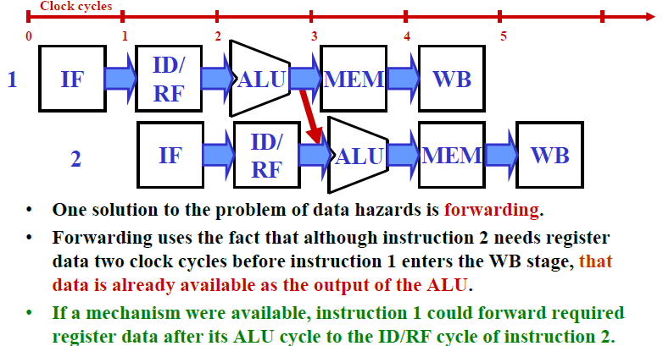
Forwarding As A solution of Data Hazards

Slide 22
Data Hazards
Data hazard: instruction needs data from the result of a previous instruction still executing in pipeline
Solution Forward data if possible…
Instruction pipeline diagram: shade indicates use : left=write, right=read
P
r
o
g
r
e
a
m
x
e
c
u
t
i
o
o
n
2
4
6
8
1
0
r
d
e
r
T
i
m
(
e
i
n
i
n
s
t
r
u
c
t
i
o
n
s
)
Without forwarding – blue line – data has to go back in time;
with forwarding – red line –
data is available in time
a
d
d
$
s
0
,
$
t
0
,
$
t
1
I
F
I
D
E
X
M
E
M
W
B
s
u
b
$
t
2
,
$
s
0
,
$
t
3
I
M
E
M
F
I
D
E
X
M
E
M
W
B

Slide 23
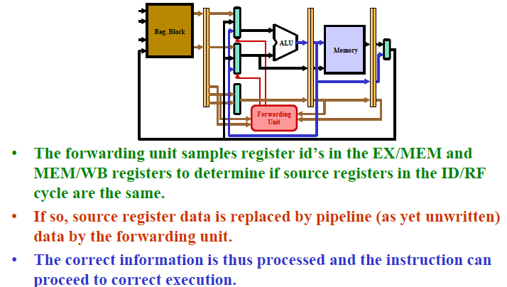
Forwarding Operation

Slide 24
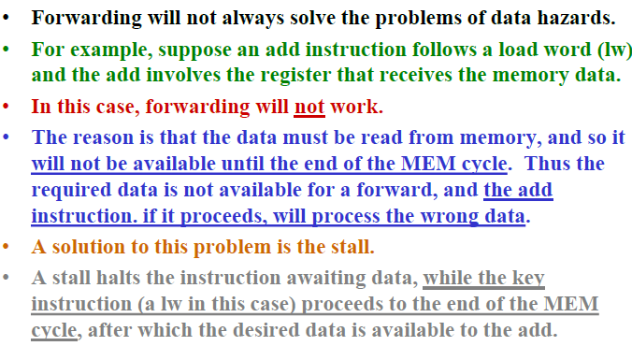
Stalls

Slide 25
Data Hazards
Forwarding may not be enough
e.g., if an R-type instruction following a load uses the result of the load – called load-use data hazard
T
i
m
e
2
4
6
8
1
0
1
2
1
4
P
r
o
g
r
a
m
e
x
e
c
u
t
i
o
n
o
r
d
e
r
(
i
n
i
n
s
t
r
u
c
t
i
o
n
s
)
Without a stall it is impossible
to provide input to the sub
instruction in time
l
w
$
s
0
,
2
0
(
$
t
1
)
I
F
I
D
E
X
M
E
M
W
B
s
u
b
$
t
2
,
$
s
0
,
$
t
3
I
F
I
D
E
X
M
E
M
W
B
With a one-stage stall, forwarding
can get the data to the sub
instruction in time

Slide 26
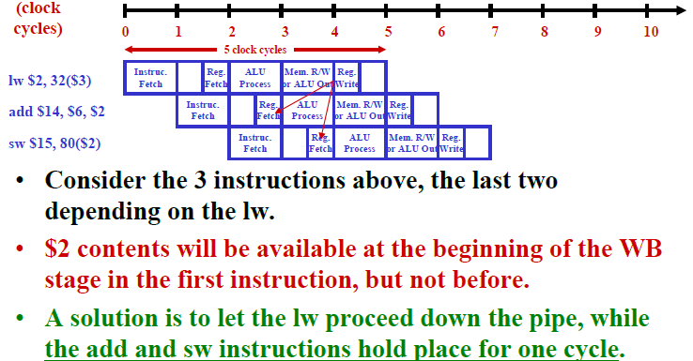
Result of Stall Approach

Slide 27
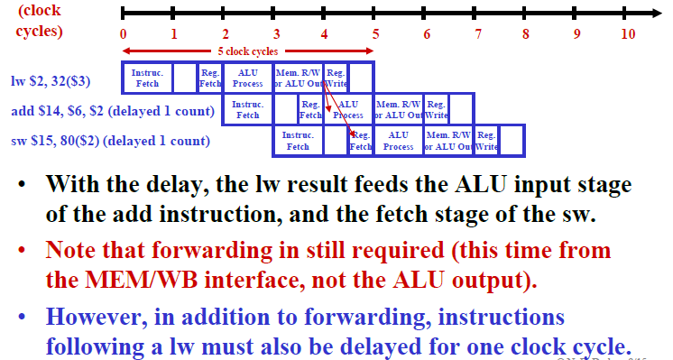
Result of Stall Approach -II

Slide 28
Reordering Code to Avoid Pipeline Stall (Software Solution)
Example:
lw $t0, 0($t1)
lw $t2, 4($t1)
sw $t2, 0($t1)
sw $t0, 4($t1)
Reordered code:
lw $t0, 0($t1)
lw $t2, 4($t1)
sw $t0, 4($t1)
sw $t2, 0($t1)
Data hazard
Interchanged

Slide 29
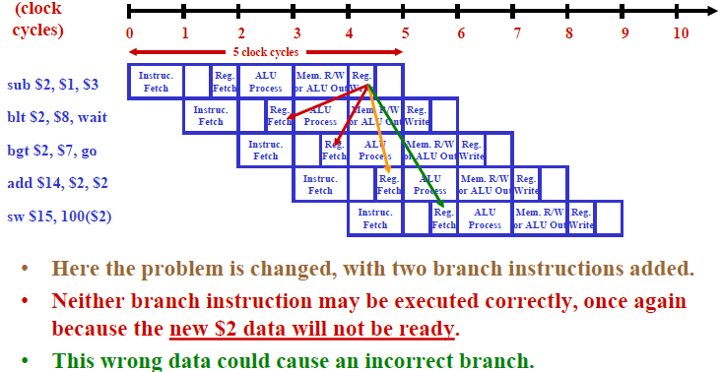
Control Hazards

Slide 30
Control Hazards
Control hazard: need to make a decision based on the result of a previous instruction still executing in pipeline
Solution 1: Stall the pipeline
P
r
o
g
r
a
m
e
x
e
c
u
t
i
o
n
2
4
6
8
1
0
1
2
1
4
1
6
o
r
d
e
r
T
i
m
e
(
i
n
i
n
s
t
r
u
c
t
i
o
n
s
)
I
n
s
t
r
u
c
t
i
o
n
R
e
g
A
L
U
D
a
t
a
R
e
g
Note that branch outcome is
computed in ID stage with
added hardware
a
d
d
$
4
,
$
5
,
$
6
f
e
t
c
h
a
c
c
e
s
s
b
e
q
$
1
,
$
2
,
4
0
I
n
s
t
r
u
c
t
i
o
n
R
e
g
A
L
U
D
a
t
a
R
e
g
2
n
s
f
e
t
c
h
a
c
c
e
s
s
l
w
$
3
,
3
0
0
(
$
0
)
b
u
b
b
l
e
I
n
s
t
r
u
c
t
i
o
n
R
e
g
A
L
U
D
a
t
a
R
e
g
f
e
t
c
h
a
c
c
e
s
s
4
n
s
2
n
s
Pipeline stall

Slide 31
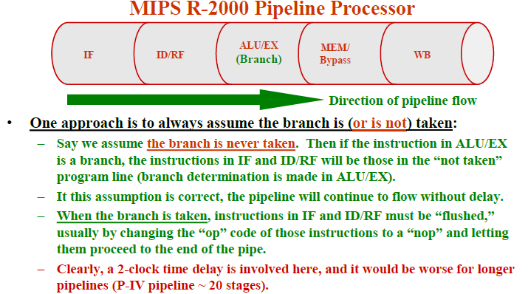
Control Hazards: Prediction

Slide 32
Control Hazards
Solution 2: Predict branch outcome
e.g., predict branch-not-taken :
Prediction success
Prediction failure: undo (=flush) lw

Slide 33
Control Hazards
Solution 3: Delayed branch: always execute the sequentially next statement with the branch executing after one instruction delay
– compiler’s job to find a statement that can be put in the slot that is independent of branch outcome
P
r
o
g
r
a
m
e
x
e
c
u
t
i
o
n
2
4
6
8
1
0
1
2
1
4
o
r
d
e
r
T
i
m
e
(
i
n
i
n
s
t
r
u
c
t
i
o
n
s
)
b
e
q
$
1
,
$
2
,
4
0
I
n
s
t
r
u
c
t
i
o
n
R
e
g
A
L
U
D
a
t
a
R
e
g
f
e
t
c
h
a
c
c
e
s
s
a
d
d
$
4
,
$
5
,
$
6
I
n
s
t
r
u
c
t
i
o
n
R
e
g
A
L
U
D
a
t
a
R
e
g
(
d
e
l
a
y
e
d
b
r
a
n
c
h
s
l
o
t
)
2
n
s
f
e
t
c
h
a
c
c
e
s
s
l
w
$
3
,
3
0
0
(
$
0
)
I
n
s
t
r
u
c
t
i
o
n
R
e
g
A
L
U
D
a
t
a
R
e
g
2
n
s
f
e
t
c
h
a
c
c
e
s
s
2
n
s
Delayed branch beq is followed by add that is independent of branch outcome

Slide 34
References
John L. Hennessy and David A Patterson, Computer Architecture: A quantitative Approach, Morgan Kaufmann / Elsevier, Sixth Edition, 23rd November 2017

